Slide 1
FREEBIES FOR NEWBIES
A place to find free event and items
Team Members:
Manoj Kumar Gude
Harish Chowdary Bala
Aditya Krishna Raavi
Jaichand Mulakalapalli
Saibabu Devarapalli
Client & Mentor:
Dr. Chandra Mouli Kotteti

Slide 2
Team Members
JAICHAND MULAKALAPALLI
(TEAM LEADER) BACKEND
MANOJ KUMAR GUDE
FRONTEND
ADITHYA KRISHNA RAAVI
FRONTEND
Saibabu devarapalli
Fullstack
HARISH CHOWDARY BALA
DATABASE
DR. CHANDRA MOULI KOTTETI
Mentor & Client

Slide 3
Table of Contents
Scroll View In Android
Action Bar (Navigation Bar)
Back4App Database
RecylerViews
Lessons Learned
Summary
Date Picker and Time Picker
Introduction

Slide 4




Introduction
Freebies for Newbies is an android application, which helps international students to access to free items and events in the desired location.
Tools and Design:
Android Studio - The tool used for the UI development.
GenyMotion - Emulator (Virtual device).
Git Hub - To integrate UI part and store it.
Oracle VirtualBox - Its an essential tool required to run for GenyMotion.
Back4App - Database.
Programming Language:
Java

Slide 5
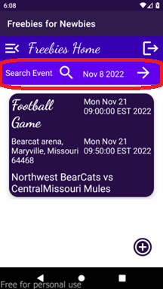
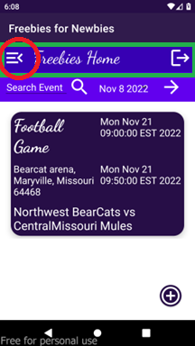
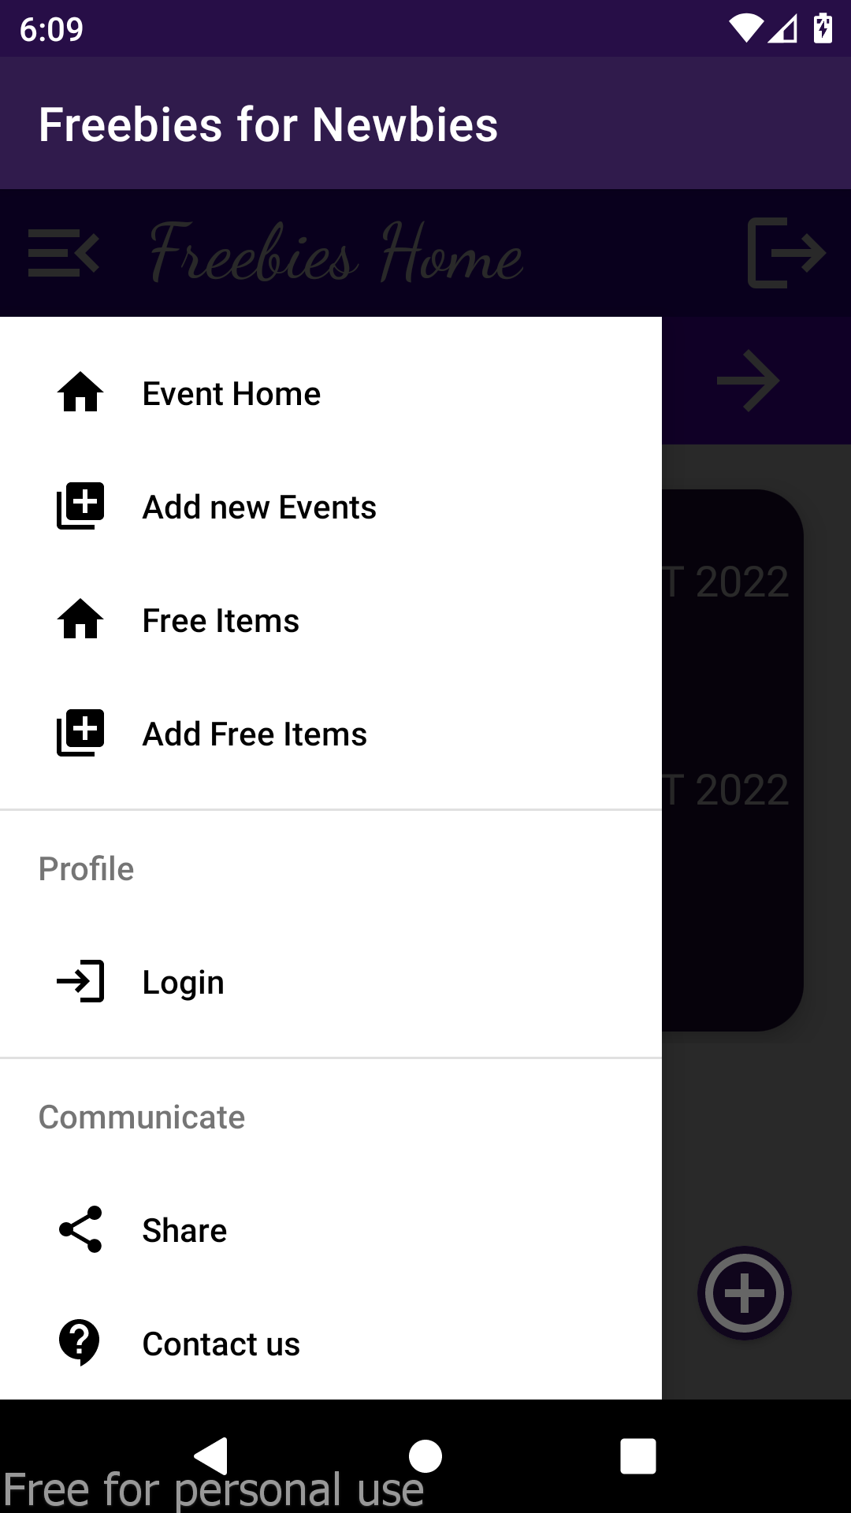
Action Bar (Navigation Bar)
An Action Bar is a place to display navigational controls, Controls to support switching from one view to another using menu options.
Fig. 1: Search toolbar and Navigation bar with different controls like menu options, home, logout etc.,

Slide 6
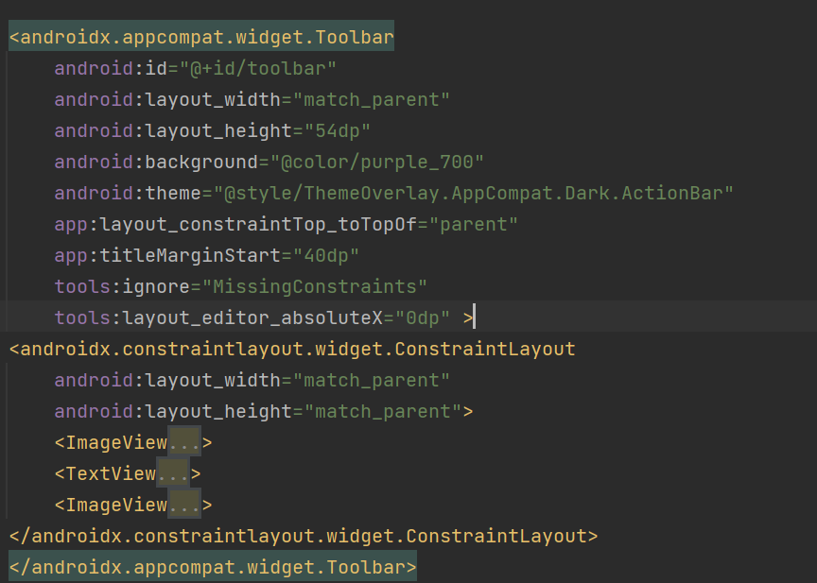
Action Bar (Navigation Bar)
Fig. 2: Navigation bar XML code

Slide 7
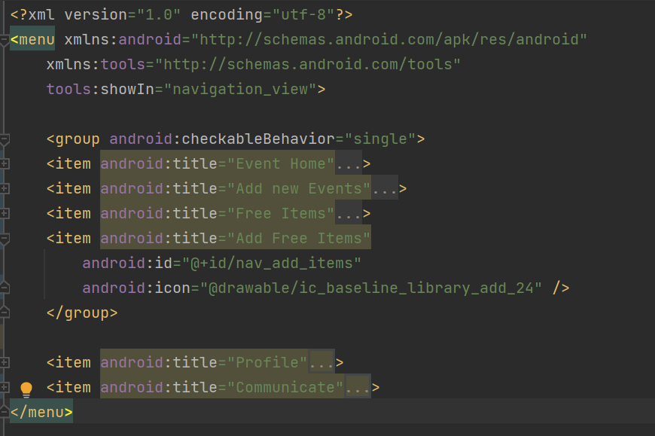
Action Bar (Navigation Bar)
Fig. 3: Menu items XML code

Slide 8
Database: Back4App
Store and query relational data on the cloud. Make it accessible over GraphQL and REST with a scalable, open-source backend.
Spin up a new database in minutes with Back4App.
Effortlessly define your relational data model using either our intuitive UI or programmatically via GraphQL, REST, or SDKs.
Perform diverse queries using advanced resources: relational queries, geo-queries, constraints, and aggregates.
Fetch data from your application using GraphQL, REST or your preferred SDK.
Its automatically generated APIs include endpoints for all operations and make easy for us to interact with all backend features with few lines of code.

Slide 9
Back4App: Parse Object Create Query
createBtn.setOnClickListener( v -> { try{ ParseObject eventObject = new ParseObject("Events"); // Store an object eventObject.put("eventName",eNameET.getText().toString()); eventObject.put("eventDescription",eDescET.getText().toString()); eventObject.put("eventNotes",eNotesET.getText().toString()); eventObject.put("eventAddressLine1",eAddLine1ET.getText().toString()); eventObject.put("eventAddressLine2",eAddLine2ET.getText().toString()); eventObject.put("eventCity",eCityET.getText().toString()); eventObject.put("eventState",eStateET.getText().toString()); eventObject.put("eventCountry",eCountryET.getText().toString()); eventObject.put("eventZipcode",eZipET.getText().toString()); String stDateTime=eStDtET.getText().toString(); String endDateTime=eEndDtET.getText().toString(); DateFormat formatter=new SimpleDateFormat("MM/dd/yyyy HH:mm"); Date stdate=formatter.parse(stDateTime); Date etdate=formatter.parse(endDateTime); eventObject.put("eventStartDt",stdate); eventObject.put("eventEndDt", etdate);
Fig. 4.1: Create Query Part-1

Slide 10
Back4App: Parse Object Create Query
// Saving object eventObject.saveInBackground(new SaveCallback() { @Override public void done(ParseException e) { progressDialog.dismiss(); if (e == null) { // Success showAlert("Successfully saved..!\n", "Your object has been saved in Events class."); } else { // Error Toast.makeText(CreateEventActivity.this, e.getMessage(), Toast.LENGTH_LONG).show(); } } }); }catch (Exception e){ Toast.makeText(CreateEventActivity.this, e.getMessage(), Toast.LENGTH_LONG).show(); } }); }
Fig. 4.2: Create Query part-2

Slide 11
Back4App: Parse Object Read Query
// Read Parse Objects
ParseQuery<ParseObject> query = ParseQuery.getQuery("Events");
query.whereGreaterThanOrEqualTo("eventStartDt", dateToday); query.findInBackground(new FindCallback<ParseObject>() { @Override public void done(List<ParseObject> results, ParseException e) { for (ParseObject eventObj : results) { if (e == null) { String eventID, eventName, eventStDT, eventEndDt, eventDescription,eventAddressLine1, eventAddressLine2, eventCity,eventState, eventCountry, eventZipcode, eventNotes; eventID= eventObj.getObjectId(); eventName = eventObj.getString("eventName"); eventStDT = String.valueOf(eventObj.getDate("eventStartDt")); eventEndDt = String.valueOf(eventObj.getDate("eventEndDt")); eventDescription = eventObj.getString("eventDescription"); eventAddressLine1 = eventObj.getString("eventAddressLine1") ; eventAddressLine2 = eventObj.getString("eventAddressLine2"); eventCity= eventObj.getString("eventCity") ; eventState= eventObj.getString("eventState") ; eventCountry= eventObj.getString("eventCountry"); eventZipcode= eventObj.getString("eventZipcode") ; eventNotes = eventObj.getString("eventNotes"); Log.v("ObjectID",String.valueOf(eventID)); myEModel.eventsList.add(new EventModel.Events(eventID, eventName, eventStDT, eventEndDt, eventDescription, eventAddressLine1, eventAddressLine2, eventCity, eventState, eventCountry, eventZipcode, eventNotes));
Fig. 5: Read Query

Slide 12
Back4App: ParseObject Update Query
ParseQuery<ParseObject> query = ParseQuery.getQuery("Events"); // Retrieve the object by id query.getInBackground(fetchID, new GetCallback<ParseObject>() { public void done(ParseObject eventObject, ParseException e) { if (e == null) { eventObject.put("eventName",eNameET.getText().toString()); eventObject.put("eventDescription",eDescET.getText().toString()); eventObject.put("eventNotes",eNotesET.getText().toString()); eventObject.put("eventAddressLine1",eAddLine1ET.getText().toString()); eventObject.put("eventAddressLine2",eAddLine2ET.getText().toString()); eventObject.put("eventCity",eCityET.getText().toString()); eventObject.put("eventState",eStateET.getText().toString()); eventObject.put("eventCountry",eCountryET.getText().toString()); eventObject.put("eventZipcode",eZipET.getText().toString()); String stDateTime=eStDtET.getText().toString(); String endDateTime=eEndDtET.getText().toString(); DateFormat formatter=new SimpleDateFormat("MM/dd/yyyy HH:mm"); Date stdate= null; Date etdate= null;
Fig. 6.1: Update Query part-1

Slide 13
Back4App: Parse Object Update Query
try { stdate = formatter.parse(stDateTime); }
catch (java.text.ParseException ex) { Log.v("StartDate Ex:", ex.getMessage()); } try { etdate = formatter.parse(endDateTime); }
catch (java.text.ParseException ex) { Log.v("endDate Ex:", ex.getMessage()); } eventObject.put("eventStartDt",stdate); eventObject.put("eventEndDt", etdate); // Saving object eventObject.saveInBackground(new SaveCallback() { @Override public void done(ParseException e) { progressDialog.dismiss(); if (e == null) { // Success showAlert("Successfully saved..!\n", "Your object has been saved in Events class."); } else { // Error Toast.makeText(UpdateEventActivity.this, e.getMessage(), Toast.LENGTH_LONG).show(); } } }); } else { // Failed
Toast.makeText(UpdateEventActivity.this, e.getMessage(), Toast.LENGTH_LONG).show(); } } });
Fig. 6.2: Update Query part-2

Slide 14
Back4App: Parse Object Delete Query
ParseQuery<ParseObject> eventObjects = ParseQuery.getQuery("Events"); // Query parameters based on the item name eventObjects.whereEqualTo("objectId", fetchID); eventObjects.findInBackground(new FindCallback<ParseObject>() { @Override public void done(final List<ParseObject> event, ParseException e) { if (e == null) { event.get(0).deleteInBackground(new DeleteCallback() { @Override public void done(ParseException e) { if (e == null) { showAlert("Delete Status:", "Object has been deleted Successfully"); }
else { Log.v("Delete Inner Ex:",e.getMessage()); } } }); }else { Log.v("Delete Parse Outer Ex: ",e.getMessage()); } }
Fig. 7: Delete Query

